Slide 1
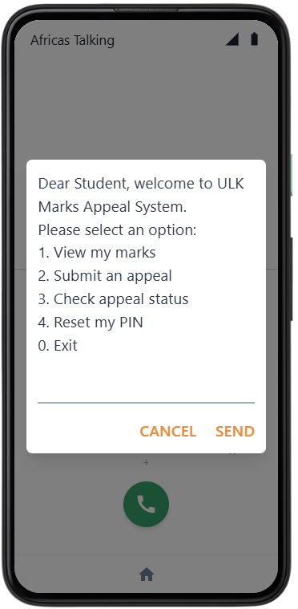
UNIVERSITE OF KIGALI (UoK)
USSD-Based Marks Appeal System
with PIN-Secured Student Authentication
A Case Study of University Libre de Kigali (ULK)
Presented by: BIKORIMANA Jean Baptiste | Reg. No: 2205000458
Supervisor: Mr. ISHIMWE Olivier Angel Kevin
Programme: Bachelor of Information Technology (Final Year) | June 2026
Final Defense Presentation 2026
Notes:
Welcome the panel. Introduce yourself: name, registration number, programme. State the title clearly.

Slide 2
PRESENTATION OUTLINE
01
Background & Problem Statement
05
Implementation Demo
02
Research Objectives
06
Conclusions & Recommendations
03
Methodology
07
Q & A
04
System Design & Architecture
Notes:
This is the flow of the presentation. We have 7 sections. Slide 5 is the implementation demo which replaces the testing section.

Slide 3

BACKGROUND & PROBLEM STATEMENT
The Problem at ULK
What Our Survey Found
• Paper forms only no digital channel • Students visit office in person • No real-time status notification • Documents get lost or misplaced • No identity authentication • 2–6 weeks average resolution time • No central record of all appeals
76.3%
never informed of status in real time
44.9%
waited 2–4 weeks for resolution
97.0%
own a USSD-capable phone
89.8%
prefer a USSD-based system
94.7%
of HODs: delayed responses are the #1 challenge
Notes:
Explain the current manual process. Survey involved 372 students and 19 HODs/Deans. Highlight the 76.3% and 97% stats they tell the whole story.

Slide 4




RESEARCH OBJECTIVES
General Objective: To design and implement a USSD-Based Marks Appeal System with PIN-Secured Student Authentication as a case study of ULK
Analyse:
Analyse the existing marks appeal process at ULK and identify its key limitations
Design:
Design a secure PIN authentication mechanism using SHA-256 hashing, 3-strike lockout, and OTP-based reset
Develop:
Develop a USSD interface for marks viewing, appeal submission and status tracking no internet required
Implement:
Implement a web-based administration portal for administrators and HODs to manage all appeals
Evaluate:
Test and evaluate the system through unit, validation, integration, functional, and acceptance testing
Notes:
Walk through each specific objective. Each one maps to a chapter or section of the book. Objective 5 (testing) note that for this presentation, we will demo the live system instead.

Slide 5
RESEARCH METHODOLOGY
Research Design
Technology Stack
Mixed-methods: quantitative surveys + qualitative interviews using Design Science Research (DSR) framework
Backend:
Python 3.10 + Flask 2.x
Population & Sample
Database:
MySQL 8.0 (Railway.app)
391 respondent's total: 372 students (stratified random sampling) + 19 HODs/Deans (census method)
USSD/SMS:
Africa's Talking API
Data Collection
Security:
SHA-256 hashing (hashlib)
Questionnaires, semi-structured interviews, document review of existing appeal records and registers
Frontend:
Bootstrap 5 + Jinja2
Time Scope
Deployment:
Render.com (HTTPS)
February 2025 – June 2026 (18 months): collection February 2026 to June 2026; development Oct 2025–Feb 2026
Dev Method:
Agile 6 Sprints
Notes:
Explain DSR: the system itself IS the research contribution. Mention that 372 is a statistically valid sample for ULK's student population. Time scope correction was a panel comment now clarified as 4 months.

Slide 6



SYSTEM DESIGN & ARCHITECTURE
STUDENT
USSD GATEWAY
ADMIN / HOD
Any GSM Phone
Africa's Talking
Web Browser
▸ Dial USSD short code(*384*44158#)
▸ Receives GSM input
▸ Login to portal
▸ Register / Enter PIN
▸ HTTP POST to Flask
▸ View all appeals
↔
↔
▸ View marks
▸ Returns CON/END
▸ Update status
▸ Submit appeal
▸ Delivers OTP via SMS
▸ Review audit log
▸ Check appeal status
▸ Session management
▸ Download records
MySQL 8.0 7 Tables | Render.com Deployment
Notes:
Three actors: Student uses USSD, Africa's Talking is the gateway in the middle, Admin/HOD uses the web portal. All connected to MySQL database. No internet needed for students USSD runs over GSM signalling channel.

Slide 7




ORIGINAL CONTRIBUTION PIN SECURITY MECHANISM
1
2
3
4
5
→
→
→
→
Student Enters PIN
SHA-256 Hashing
DB Comparison
3-Strike Lockout
OTP Reset via SMS
4-digit PIN entered via USSD keypad on any GSM phone
hashlib.sha256(pin.encode()).hexdigest() 64-char digest, plaintext NEVER stored
Hashed PIN compared against stored hash in pin_credentials table
3 wrong attempts → is_locked = 1. Account locked, student cannot retry
6-digit OTP sent via Africa's Talking SMS API. Expires in 10 minutes
🔒 SHA-256 | 3-Strike Lockout | OTP SMS Reset (10-min expiry) | NIST SP 800-63B Compliant | No Plaintext PIN Ever Stored
Notes:
This is the ORIGINAL CONTRIBUTION of the research. No prior study at ULK has implemented this mechanism. Emphasise: SHA-256 means even if the database is stolen, PINs cannot be recovered. The 3-strike lockout prevents brute-force.

Slide 8
DATABASE DESIGN 7-TABLE RELATIONAL SCHEMA
students
student_id · full_name · phone · department
appeals
student_id · module · reason · status_id
admins
username · password (SHA-256 hash)
pin_credentials
pin_hash · failed_attempts · is_locked · otp
marks
student_id · module_name · mark · semester
access_audit
student_id · action · success · timestamp
appeal_status
status_name: Pending / Approved / Rejected
All tables normalised to 3NF · Full foreign key constraints · UTF8MB4 charset
Notes:
Seven tables. The pin_credentials table is the security core stores SHA-256 hash, lock flag, failed attempts, and OTP. The access_audit table logs every USSD action. All normalised to 3NF no data redundancy.

Slide 9
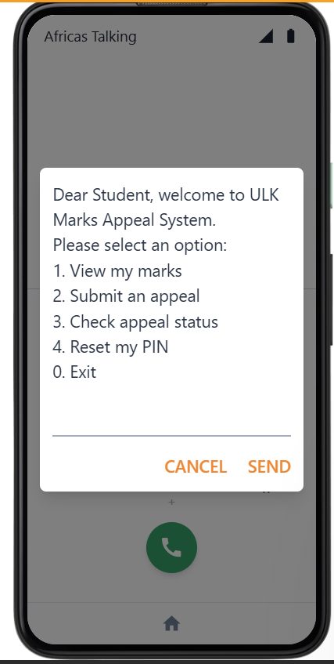
USSD MENU FLOW STUDENT INTERACTION
1
1. Dial short code
Student dials *384*44158# Africa's Talking sends HTTP POST to Flask /ussd
2
2. Enter Student ID
Flask prompts for registration number
3
3. Enter PIN
Student enters 4-digit PIN Flask hashes and compares against DB
4
4. Select action
Authenticated: view marks, submit appeal, or check status
5
5. Get response
Flask returns CON (continue) or END (terminate) to student's screen
Notes:
USSD does NOT need internet this addresses the panel comment. It runs over the GSM signalling channel, same as SMS. Every student with a SIM card can access it. Emphasise the 180-second session timeout for security.

Slide 10




IMPLEMENTATION DEMO
Live System Walkthrough
USSD Session
PIN Lockout & Reset
Admin Dashboard
Live demo: dial short code → PIN auth → view marks → submit appeal
Enter wrong PIN 3 times → account locks → OTP received via SMS → reset
Login to web portal → view all appeals → update status to Approved
Audit Log
Database Records
Student Status Check
View access_audit table every USSD event logged with timestamp
Show MySQL: appeals table updated in real-time after USSD submission
Student dials again → checks status → sees 'Approved' in real time
System deployed on Render.com · Africa's Talking Sandbox · MySQL on Railway.app
Notes:
THIS IS THE CORE SLIDE. Open the browser now. Demo in order: 1) USSD session on AT simulator, 2) wrong PIN 3 times then OTP reset, 3) admin portal show the appeal appeared, update it, 4) student checks status and sees Approved.

Slide 11

KEY RESULTS
100%
97.1%
1.8s
0
Pass Rate
All 37 Test Cases
Acceptance Rate
7 User Participants
Avg USSD Response
(Target: < 5 sec)
Critical Defects
Found in Testing
Testing Phases: Unit (10) · Validation (8) · Integration (7) · Functional & System (12) · Acceptance (70 tasks)
All 10 Functional Requirements Successfully Met:
FR1: PIN Registration
FR6: Appeal Submission
FR2: PIN Authentication
FR7: Status Check
FR3: 3-Strike Lockout
FR8: Admin Dashboard
FR4: OTP Reset
FR9: Status Management
FR5: Marks Viewing
FR10: Audit Logging
Notes:
All functional requirements passed. Average USSD response of 1.8 seconds is well within the Africa's Talking 30-second timeout. Zero critical defects found during acceptance testing.

Slide 12





CONCLUSIONS
Problem Confirmed:
Survey data confirmed ULK's appeal process is manual, slow, and insecure 76.3% of students never informed of status in real time.
Security Achieved:
SHA-256 PIN hashing, 3-strike lockout, and OTP reset constitute an original and NIST-compliant authentication mechanism.
Accessibility Achieved:
97% of ULK students already own USSD-capable phones. The system works on ANY phone with a SIM no internet, no smartphone needed.
Management Improved:
The centralised web portal gives administrators and HODs a single dashboard replacing fragmented paper-based appeal management.
Original Contribution:
First study at ULK to implement PIN-based USSD authentication for an academic service. Fills a documented gap in East African literature.
Notes:
Five key conclusions, one per objective. Stress the 'original contribution' this was not done at ULK before. The panel will appreciate that conclusion 3 directly addresses their comment about USSD not needing internet.

Slide 13


RECOMMENDATIONS & FURTHER RESEARCH
Recommendations
Areas for Further Research
1. ULK should deploy the system live with a registered USSD short code
Biometric (fingerprint/voice) authentication for USSD
2. Integrate with the existing Student Information System (SIS)
AI-based appeal outcome prediction system
4. Train all HODs and admin staff on the web portal
Multi-institution deployment across Rwanda
Mobile app companion for smartphone users
5. Conduct a formal penetration test before production launch
Longitudinal study of real appeal resolution times
Notes:
Recommendations are practical ULK can act on all five immediately. For further research, mention biometrics and AI as the most exciting next steps.

Slide 14

Thank You
Questions & Answers
BIKORIMANA Jean Baptiste · Reg. No: 2205000458 · Bachelor of IT
Supervisor: Mr. ISHIMWE Olivier Angel Kevin
"Any student with a SIM card can now appeal their marks securely, instantly, from any phone."
Notes:
Close with confidence. Invite questions. Likely panel questions: 1) Why USSD over a mobile app? (Answer: 97% own USSD phones, 0% need internet) 2) How secure is SHA-256? (Answer: NIST-recommended, computationally irreversible) 3) What happens if Africa's Talking goes down? (Answer: identified as a limitation future work includes failover SMS gateway)

